Slide 1
Lecture 5 Activity Diagram
Chapter 20
The Unified Modeling Language User Guide
SECOND EDITION
By Grady Booch, James Rumbaugh, Ivar Jacobson
Session 14

Slide 2
Introduction
An activity diagram is essentially a flowchart, showing flow of control from activity to activity.
Unlike a traditional flowchart, an activity diagram shows concurrency as well as branches of control.
You use activity diagrams to model the dynamic aspects of a system. For the most part, this involves modeling the sequential and concurrent steps in a computational process.
An activity is a behavior that specifies the sequence of steps a computational process performs.
Behavioral thing that focuses on the flows among computational steps without regard to which object performs each step.
A step of an activity is called an action.

Slide 3
Elements
Activity diagrams commonly contain:
Actions
Activity nodes
Flows
Object values

Slide 4
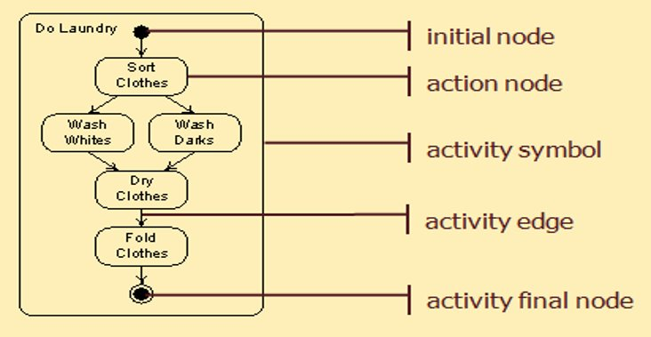

Slide 5
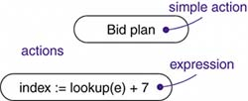
Actions and Activity Nodes
Actions: Atomic computations are called actions, like, call an operation on an object, send a signal to an object, or even create or destroy an object. Actions can't be decomposed (actions are atomic), meaning you can't execute part of an action; either it executes completely or not at all.

Slide 6

Actions and Activity Nodes
Activity: An activity node is an organizational unit within an activity. In general, activity nodes are nested groupings of actions or other nested activity nodes. Like, evaluate some expression that sets the value of an attribute or that returns some value.

Slide 7
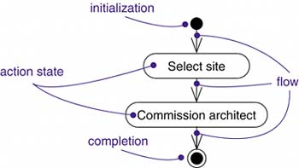
Control Flow
Control Flow: A flow is represented as a simple arrow from the predecessor action to its successor, without an event label. A flow of control has to start and end someplace.

Slide 8
Guard condition and decision
Guard Condition:
Decision: (One incoming and multiple alternate outgoing )

Slide 9
Merge Point, Start and End
Merge Point: (Multiple alternate incoming and one outgoing )
Start and End (must be present in activity diagram):

Slide 10
Concurrency
Forking and Synchronization: Number of outgoing concurrent flows out of a forking must match with the number of incoming concurrent flows in its respective synchronization (joining).
Forking: (One incoming and multiple parallel outgoing)
Synchronization/ Joining: (Multiple parallel incoming and one outgoing )

Slide 11
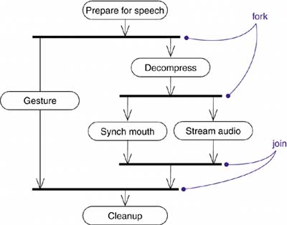
Concurrency (Example)

Slide 12
Swimlane
Swimlane: Modeling workflows of business processes, to partition the activity states on an activity diagram into groups, each group representing the business organization responsible for those activities. Each swimlane has a name unique within its diagram. A swimlane really has no deep semantics, except that it may represent some real-world entity, such as an organizational unit of a company.

Slide 13
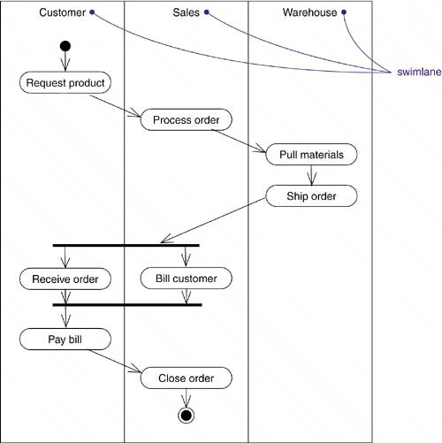
Swimlane (Example)

Slide 14
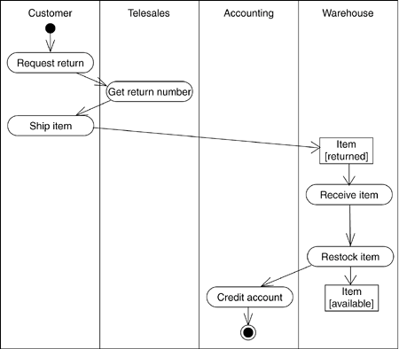
Object Flow
Objects may be involved in the control flow associated with an activity. Usually how the state of object changes is shown with object flow.

